Slide 1



Semiconductor Detector
Research and Development at
the Helsinki Institute of Physics (HIP)
Doc. chief engineer Eija Tuominen / PaRaDeSEC seminar 3.5.2019

Slide 2


OUTLOOK
Helsinki Institute of Physics, HIP
Detector Laboratory @ HIP
Silicon detectors @ Detector Laboratory
  Motivation
  Research & Development
  CERN In-Kind Contributions
Micronova Nanofabrication Centre
Doc. chief engineer Eija Tuominen / PaRaDeSEC seminar 3.5.2019

Slide 3





Helsinki Institute of Physics (HIP)
HIP is a national research institute operated jointly by University of Helsinki, Aalto University, University of Jyväskylä, Lappeenranta-Lahti University of Technology, and Tampere University.
HIP research activity covers theoretical physics, experimental particle physics and instrumentation of physics.
HIP is responsible for the Finnish collaboration with CERN and FAIR.
Doc. chief engineer Eija Tuominen / PaRaDeSEC seminar 3.5.2019

Slide 4
Detector Laboratory: Mission
HIP instrumentation takes place in Helsinki Detector Laboratory.
Detector Laboratory is a permanent infrastructure of Helsinki Institute of Physics (HIP) and University of Helsinki / Department of Physics (UH/Physics) with three main tasks:
  Support the Finnish instrumentation of particle and nuclear physics experiments, such as CERN and FAIR
  Support the education of experimental particle physics
  Participate in externally funded R&D projects
Doc. chief engineer Eija Tuominen / PaRaDeSEC seminar 3.5.2019

Slide 5
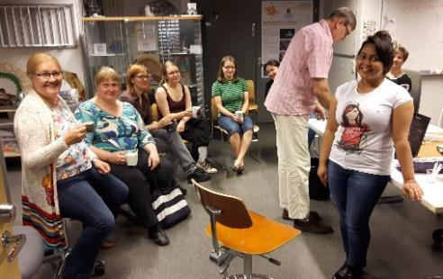
Detector Laboratory: Team
Permanent laboratory staff:
  Chief engineer: Doc. Eija Tuominen
  Two laboratory engineers & laboratory technician
~20 research scientists and students:
  Dr. Panja Luukka & CMS team
  Prof. Kenneth Österberg & TOTEM team
  Dr. Tuomas Grahn & FAIR team
  Prof. Peter Dendooven & nuclear safety team
Collaboration with universities, institutes and companies (Helsinki, Jyväskylä, Lappeenranta, Aalto, STUK, Micronova, CERN, RD50, RBI)
Doc. chief engineer Eija Tuominen / PaRaDeSEC seminar 3.5.2019

Slide 6
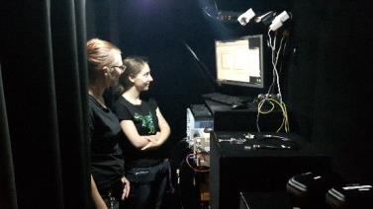
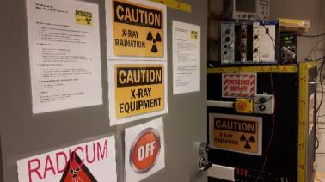
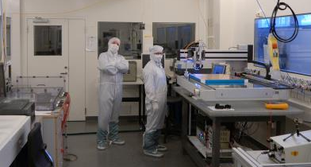
Detector Laboratory: Premises
Two research laboratories (122 m² + share of 86 m²) and three clean rooms (class 1000: 105 m² + class 100: 20 m²).
Premises contain laboratory services (e.g. gases, monitoring, alarms), chemical room, laser chamber, radiation room, mechanical workshop.
Emphasis on safety, risk management and quality management.
laser chamber
radiation room
clean room
Doc. chief engineer Eija Tuominen / PaRaDeSEC seminar 3.5.2019

Slide 7
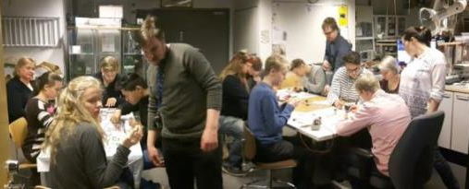
Detector Laboratory: Teaching
UH Master’s Program for Particle Physics and Astrophysical Sciences (ParAs) – module of instrumentation:
  Laboratory course on instrumentation
  Physics of semiconductor devices
  Semiconductor radiation detectors
  Gaseous radiation detectors and scintillators
Nordic laboratory course in detector technology for particle physics.
Doctoral theses, master’s theses.
Doc. chief engineer Eija Tuominen / PaRaDeSEC seminar 3.5.2019

Slide 8
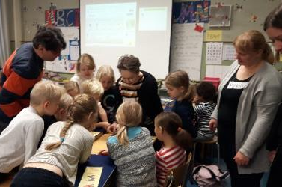
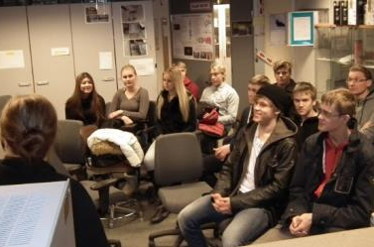
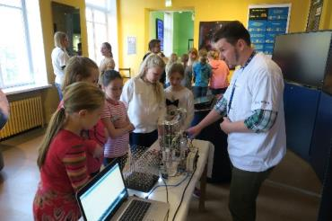
Detector Laboratory: Outreach
Encouraging young generation to the fascinating world of physics.
Disseminating information about instrumentation to general public.
E.g. visits to schools, hosting school visits, UH outreach events.
Doc. chief engineer Eija Tuominen / PaRaDeSEC seminar 3.5.2019

Slide 9
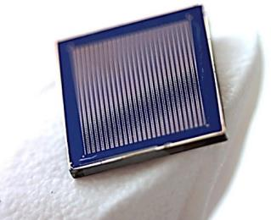
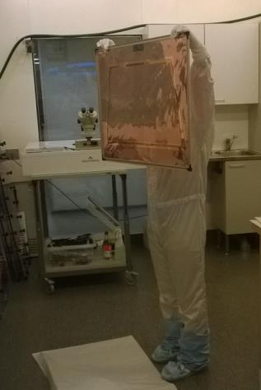
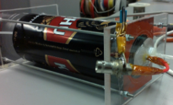
Detector Laboratory: Technologies
Detector materials:
  semiconductors: silicon, diamond, CdTe, CdZnTe
  gaseous: Gas Electron Multiplier (GEM), proportional chambers
  scintillators
Detector assembly:
  micromechanics & prototyping
  wire bonding & flip-chip bonding
Detector quality assurance (QA):
  electrical (on-chip measurements, laser-TCT)
  optical (large-area flat-bed optoscanning, microscopy)
  long-term reliability (environmental testing)
  morphological (profilometry)
  radiation response (isotope sources, X-ray source)
  radiation safety (Germanium gamma-ray imaging spectrometer GeGI)
small-size CdTe pixel detector
large-size GEM foil
beer-can detector
Doc. chief engineer Eija Tuominen / PaRaDeSEC seminar 3.5.2019
Notes:
On slide 17 you could add CdZnTe for semiconductors and Micromegas for gaseous detectors. In case of free space you could also advertise our use of scintillation materials.

Slide 10
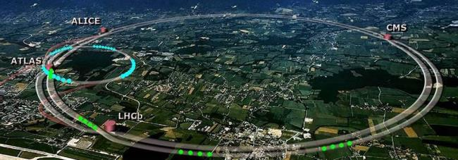
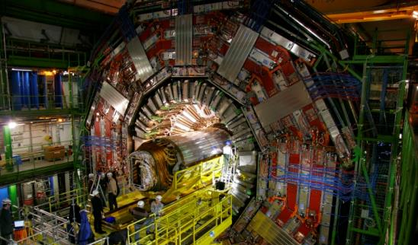
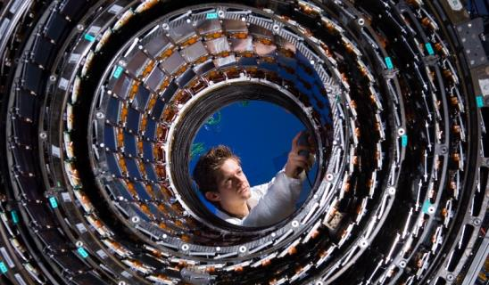
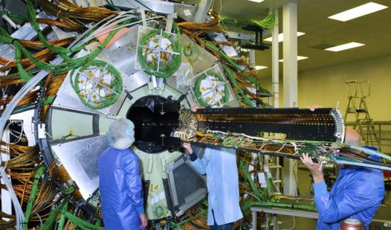
ALICE optical QA
Silicon Detectors @ the Laboratory
Silicon detectors are widely used for
track finding and particle analysis
in High Energy Physics Experiments.
Detector Laboratory is participates
especially in CERN CMS experiment.
LHC
27 km, 13 TeV
CMS
L 21 m, D 15 m, W 14,5 tn
CMS Silicon Tracker
200 m², 13-14 layers, ~9 M channels
© CERN Geneva
CMS Silicon Pixel Detector
Micronova TechTalk 27.11.2015
Eija Tuominen / HIP Detector Laboratory
10
Doc. chief engineer Eija Tuominen / PaRaDeSEC seminar 3.5.2019

Slide 11
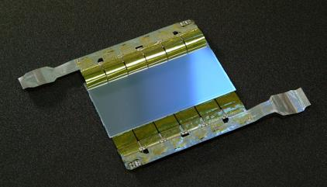
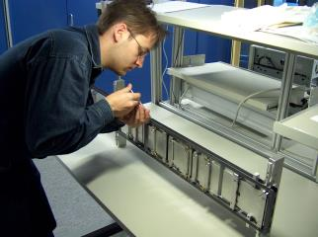
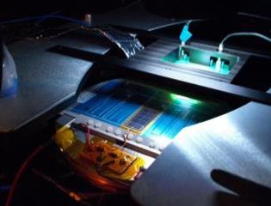
ALICE optical QA
Silicon Detectors @ the Laboratory
Detector Laboratory participates both in detector research & development and in detector in-kind contributions.
TAB bonding of 715 Silicon Strip Detector (SSD) modules for CERN ALICE Tracker, 2004-2006.
Manufacture of 700 carbon-fiber support structures for CMS Silicon Tracker, 2004-2005.
Quality Assurance of 250 silicon pixel detectors for CMS Tracker Upgrade, 2014-2016.
Doc. chief engineer Eija Tuominen / PaRaDeSEC seminar 3.5.2019

Slide 12
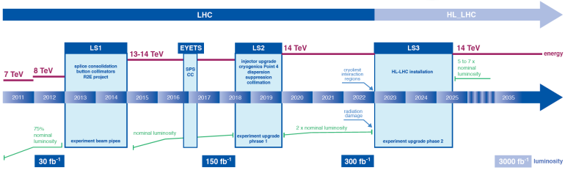
ALICE optical QA
Silicon Detector R&D
Radiation-hard silicon detectors need to be developed for future high-luminosity colliders.
E.g. CERN LHC will be upgraded to High Luminosity LHC (HL-LHC) up to 10³⁵ cm⁻²s⁻¹, to observe rare processes.
Then, upgraded CMS Tracker semiconductor detectors need to withstand fluencies to over 1x10¹⁶ 1-MeV-neutron-equivalent / cm².
Doc. chief engineer Eija Tuominen / PaRaDeSEC seminar 3.5.2019

Slide 13
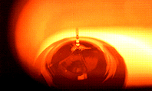
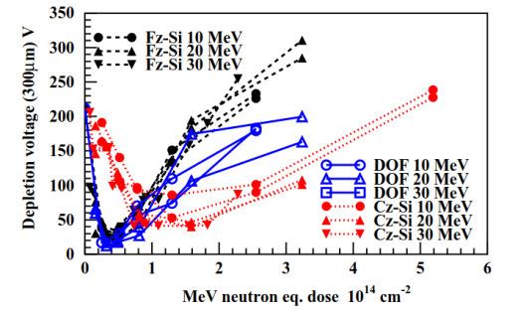
ALICE optical QA
Silicon Detector R&D: MCz-Si
We have studied oxygen-rich Magnetic Czochralski Silicon (MCz-Si) from Okmetic Ltd, Finland.
MCz-Si detectors have proved to have excellent radiation tolerance.
Härkönen, J., Tuovinen, E., Luukka, P., Tuominen, E.,& al. (2004). Radiation hardness of Czochralski silicon, Float Zone silicon and oxygenated Float Zone silicon studied by low energy protons. Nuclear Instruments and Methods in Physics Research A, 518(1-2), 346-348
Si crystal is pulled from melt while rotating
Doc. chief engineer Eija Tuominen / PaRaDeSEC seminar 3.5.2019

Slide 14
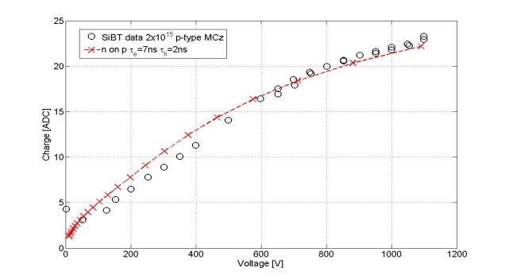
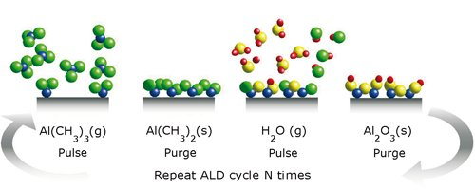
ALICE optical QA
Silicon Detector R&D: ALD
Atomic Layer Deposition (by Dr. Tuomo Suntola from Finland) is an excellent method to apply conformal thin films on MCz-Si detectors.
ALD-passivated p-type MCz-Si detectors studied show excellent radiation tolerance.
Full-size p-type MCz-Si strip detector, 768 channels, irradiated 26 MeV protons, up to 2×10¹⁵ n_{eq}/cm², CMS APV25 readout. Surface passivation made by ALD grown Al₂O₃ insulator. CCE at 600 V is 42 % and at 1100 V 60 % (full charge from reference planes is 40 ADC counts).
Doc. chief engineer Eija Tuominen / PaRaDeSEC seminar 3.5.2019

Slide 15
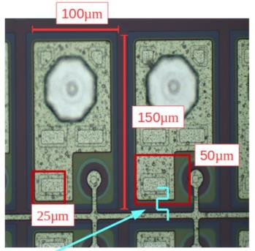
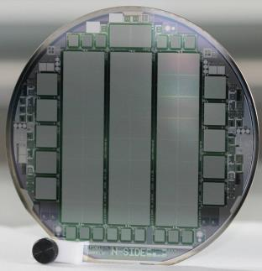
ALICE optical QA
Silicon Detector In-Kind Contribution
Detector Laboratory participated in the manufacture and quality assurance (QA) of 250 silicon pixel detector modules, corresponding to 20% of the modules of CERN CMS Tracker Phase I upgrade.
CIS, Germany
One pixel detector is a matrix of 2*8 detectors, each with 4200 pixels.
Thus, one detector has ~67000 channels.
Doc. chief engineer Eija Tuominen / PaRaDeSEC seminar 3.5.2019
http://cms.web.cern.ch/news/silicon-pixels
15

Slide 16
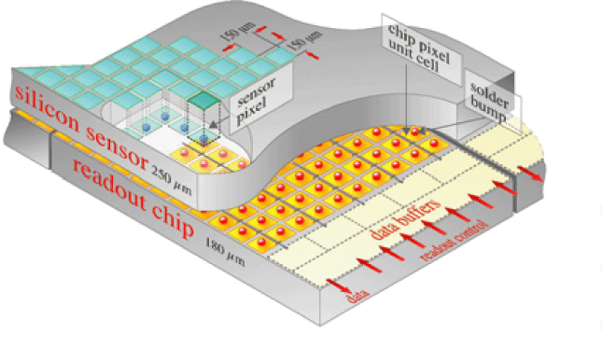
ALICE optical QA
Silicon Detector In-Kind Contribution
One Tracker pixel module consist of the pixel detector flip-chip bonded (pump-bonded) to 16 read-out CMOS chips (ROCs).
Flip-chip bonding was done by Finnish company Advacam Oy.
The required quality level was successfully reached; the average faulty interconnections in a bare pixel module was <0.1%.
Doc. chief engineer Eija Tuominen / PaRaDeSEC seminar 3.5.2019
http://cms.web.cern.ch/news/silicon-pixels
16

Slide 17



ALICE optical QA
Silicon Detector In-Kind Contribution
Next in Detector Laboratory: manufacture and QA of ~250 Silicon pixel detector modules for CMS Phase II Upgrade.
Collaborating with Ruđer Bošković Institute (RBI), Paul Scherrer Institute (PSI) and Advacam Oy.
Doc. chief engineer Eija Tuominen / PaRaDeSEC seminar 3.5.2019

Slide 18


ALICE optical QA
Micronova Nanofabrication Center
Detector Laboratory has close collaboration with Micronova Nanofabrication Center that is Finland's National Research Infrastructure for micro- and nanotechnology.
Micronova is jointly run by Aalto University and VTT Technical Research Centre of Finland.
Micronova has 2600 m² of cleanroom area with processing and measurement equipment, available for universities, research institutes and companies.
Doc. chief engineer Eija Tuominen / PaRaDeSEC seminar 3.5.2019

Slide 19
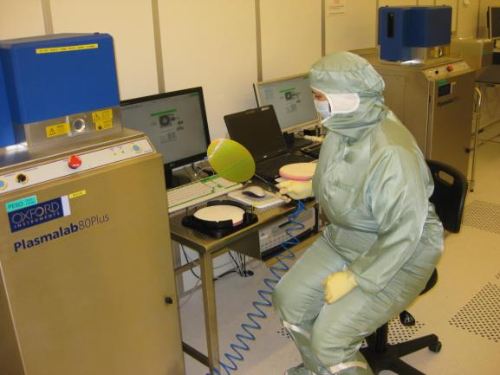
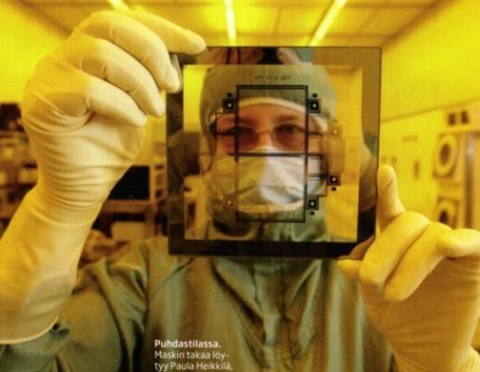
ALICE optical QA
Silicon Detectors @ Micronova
Micronova
Doc. chief engineer Eija Tuominen / PaRaDeSEC seminar 3.5.2019

Slide 20
ALICE optical QA
Summary
@ Helsinki Detector Laboratory
  We have: premises, equipment, know-how and networks
  We do: research, education, outreach and societal interaction
More info: eija.tuominen@helsinki.fi
Webpage: http://research.hip.fi/hwp/detlab/
Doc. chief engineer Eija Tuominen / PaRaDeSEC seminar 3.5.2019

Slide 21


Thank You.

